Slide 1
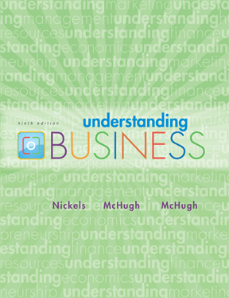

*
Chapter Four
*
Demanding Ethical and Socially Responsible Behavior
Part-1
McGraw-Hill/Irwin
Copyright © 2010 by The McGraw-Hill Companies, Inc. All rights reserved.

Slide 2
Topics to be covered in part 1:
What is ethics
What it ethical dilemma and how to deal with it

Slide 3
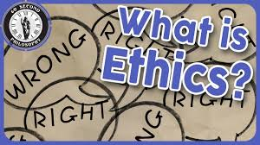

Slide 4
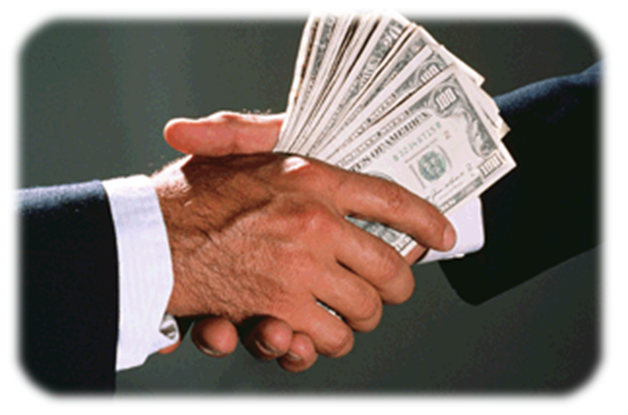
WHAT are ETHICS?
*
Ethical Standards are Fundamental
*
LG1
Ethics -- The standards of moral behavior. Behaviors that are accepted by society as right versus wrong.
4-<number>

Slide 5
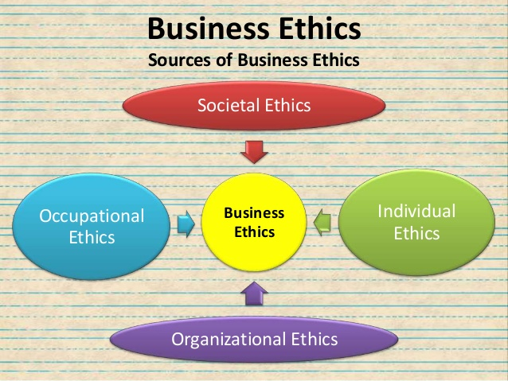

Slide 6
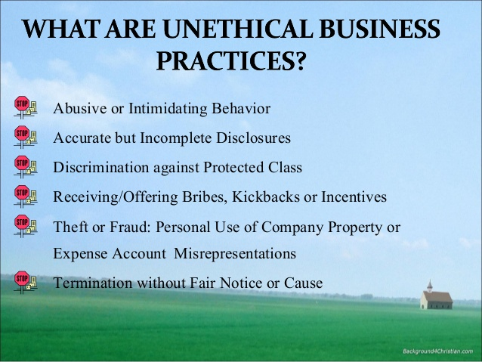

Slide 7
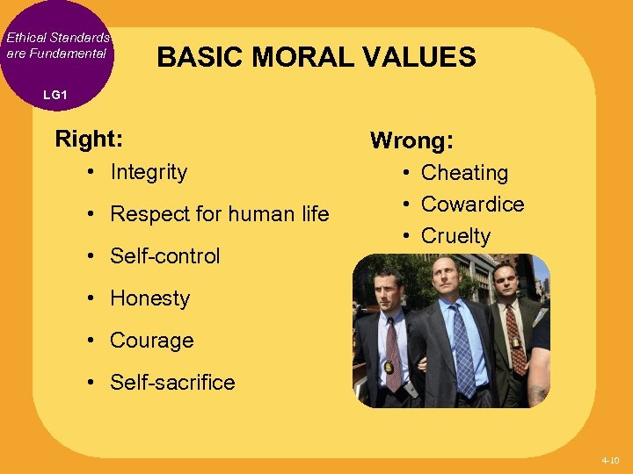
Basic Moral Values

Slide 8
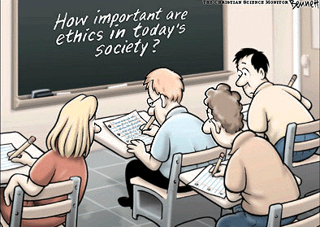
4-<number>

Slide 9
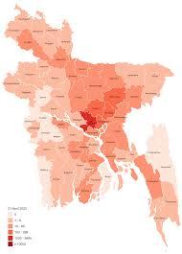
Can ethics make a difference to deal with covid19 pandemic in Bangladesh??

Slide 10

ETHICS and YOU
*
Ethics Begins with Each of Us
*
LG2
    Plagiarizing from Internet materials is the most common form of cheating in schools today.
    Studies found a strong relationship between academic dishonesty and dishonesty at work.
4-<number>

Slide 11

Ethics
More Than Legality
Ethical Standards are Fundamental
Ethics begins with each
of us
4-<number>

Slide 12
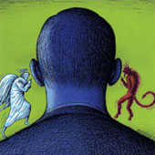
To do the RIGHT thing
4-<number>

Slide 13
FACING ETHICAL DILEMMAS
*
Ethics Begins with Each of Us
*
LG2
    Ask yourself these questions:
      Is it legal?
      Is it balanced?
      How will it make me feel about myself?
4-<number>

Slide 14
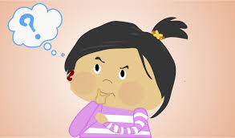
Class assessment
Do you think copying a class assignment from your friend is unethical? Why or why not?

